Slide 2
Syllabus
MODULE 6 – SECURITY ANALYSIS AND HAVIOURAL FINANCE 12h
  Fundamental Analysis: E-I-C approach. Variables used in E-I-C analysis.
  Technical Analysis Vs Fundamental Analysis.
  Efficient Market Hypothesis; Concept and Forms of Market Efficiency.
  Technical Analysis: Basic tenets and Premises of Technical Analysis; Dow Theory, Price and volume charts, Moving Averages, Relative Strength Index, Rate of change, Stochastic Oscillators .
  Behavioural finance and Technical Analysis. Introduction to Behavioural finance and how it differs from the tenets of traditional finance, Assumptions, Biases, Errors and Irrationalities that can affect Investment Behaviour and Takeaways from Behaviourists arguments

Slide 3

What is Fundamental Analysis?

Slide 4
Fundamental Analysis
Fundamental analysis is a method used to evaluate the intrinsic value of an asset, such as a stock, bond, or commodity.
It involves analyzing various factors that can affect the underlying value of the asset, including economic, financial, and qualitative factors.

Slide 5
Fundamental Analysis
Key aspects of fundamental analysis
Financial Statements
Economic Factors
Industry Analysis
Management Evaluation

Slide 6
Fundamental Analysis – EIC Approach
This is also known as the Economy-Industry-Company or the EIC approach wherein the analyst starts analyzing the economy at large and delving down further into the relevant sector and then the company in particular

Slide 7
Efficient Market Hypothesis
The Efficient Market Hypothesis (EMH) is a theory in financial economics that suggests that financial markets are efficient and that it is not possible to consistently achieve above-average returns through active trading or by using publicly available information.

Slide 8
Efficient Market Hypothesis
The core concept of the Efficient Market Hypothesis is that financial markets are informationally efficient, meaning that asset prices accurately reflect all available information at any given time.

Slide 9
Efficient Market Hypothesis
The core concept of the Efficient Market Hypothesis is that financial markets are informationally efficient, meaning that asset prices accurately reflect all available information at any given time.

Slide 10
Efficient Market Hypothesis
The Efficient Market Hypothesis is often categorized into three forms/Levels:
1. Weak Form Efficiency: In weak-form efficiency, asset prices fully reflect all historical market data, such as past prices and trading volumes. This implies that technical analysis, which involves studying historical price patterns, would not enable an investor to consistently generate excess returns.

Slide 11
Efficient Market Hypothesis
2. Semi-Strong Form Efficiency: Semi-strong form efficiency extends weak form efficiency by suggesting that asset prices reflect all publicly available information. This includes not only historical data but also news, company announcements, and other publicly disseminated information.

Slide 12
Efficient Market Hypothesis
2. Semi-Strong Form Efficiency: Semi-strong form efficiency extends weak form efficiency by suggesting that asset prices reflect all publicly available information. This includes not only historical data but also news, company announcements, and other publicly disseminated information.

Slide 13
Efficient Market Hypothesis
3. Strong Form Efficiency: Strong form efficiency is the strongest version of the Efficient Market Hypothesis, asserting that asset prices fully reflect all available information, whether it is public or private. This form of efficiency implies that even insider information, which is private and not known to the public, cannot be used to gain a sustainable advantage over other market participants.

Slide 14
Technical Analysis
Technical analysis is a method of evaluating financial markets by analysing statistical trends gathered from trading activity, such as price and volume.
The goal of technical analysis is to identify patterns and trends in the data that can help predict future price movements.

Slide 15
Technical Analysis
Technical analysts use charts and other tools to analyse market data, looking for patterns and signals that can be used to make investment decisions.
Some of the tools used in technical analysis include moving averages, trend lines, and technical indicators such as the Relative Strength Index (RSI) and the Moving Average Convergence Divergence (MACD).

Slide 16

Japanese Candle Stick
Japanese Candlesticks are a technical analysis tool that traders use to chart and analyze the price movement of securities. The concept of candlestick charting was developed by Munehisa Homma, a Japanese rice trader. During routine trading, Homma discovered that the rice market was influenced by the emotions of traders, while still acknowledging the effect of demand and supply on the price of rice.
1724-1803

Slide 17
Japanese Candle Sticks
Japanese candlesticks are a popular charting technique used in technical analysis to represent price movements in financial markets.
Each candlestick represents a specific period of time, such as one day or one hour, and includes information about the open, high, low, and closing prices of that period.

Slide 18
Candle Sticks
The body of the candlestick represents the opening and closing prices of the period, while the wicks or shadows represent the high and low prices.
If the closing price is higher than the opening price, the candlestick is typically coloured green or white to represent a bullish period. If the closing price is lower than the opening price, the candlestick is typically coloured red or black to represent a bearish period.

Slide 19
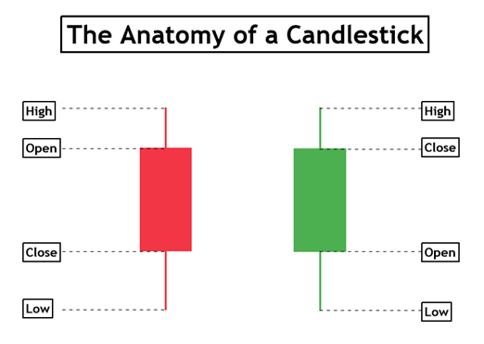
Candle Sticks

Slide 20
Moving Averages
Moving averages are a popular tool used in technical analysis to analyse price trends of financial assets, such as stocks, currencies, and commodities.
They are calculated by taking the average price of an asset over a specific period of time, and are used to identify trend direction, support and resistance levels, and potential trading opportunities.

Slide 21
Moving Averages – SMA & EMA
There are two main types of moving averages:
Simple Moving Averages (SMA) and
Exponential Moving Averages (EMA).
SMA is calculated by adding the closing price of an asset over a certain number of periods and then dividing the sum by the number of periods.
  For example, a 10-day SMA is calculated by adding the closing price of an asset for the last 10 days and then dividing the sum by 10. (EMA is calculated using a more complex formula that gives more weight to recent price action)

Slide 22
Application of SMA
Traders use moving averages in various ways.
One common method is to use two moving averages of different lengths, such as a 50-day SMA and a 200-day SMA, to identify trend direction.
If the shorter-term SMA crosses above the longer-term SMA, it is considered a bullish signal, indicating that the trend is likely to continue upwards.
If the shorter-term SMA crosses below the longer-term SMA, it is considered a bearish signal, indicating that the trend is likely to continue downwards.

Slide 23
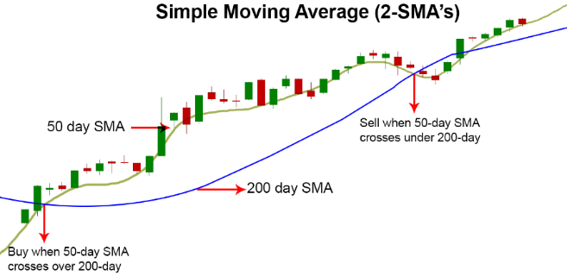
Application of 2-SMAs – 50 & 200

Slide 24
Analyse NIFTY & BANKNIFTY with 50 & 200-Day Moving Averages

Slide 25
Analyse INFY, SBIN, TATAMOTORS & RELIANCE with 50 & 200-Day Moving Averages

Slide 26

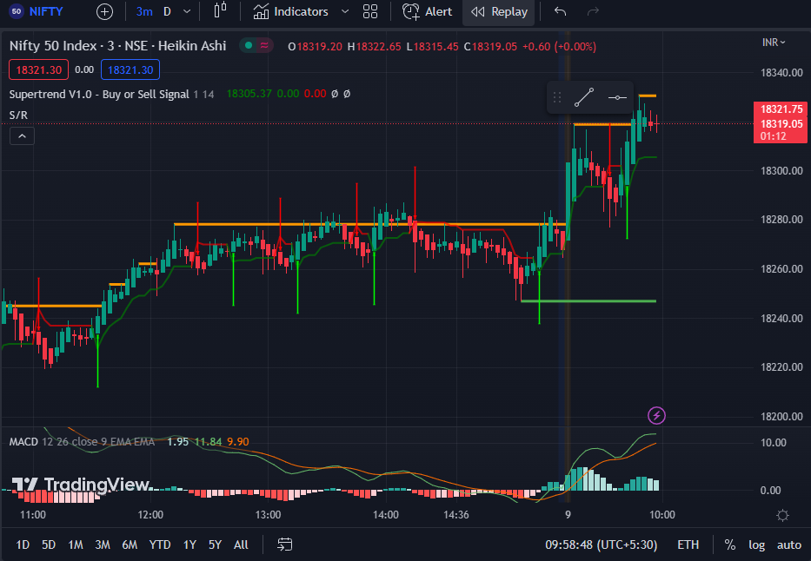
MACD

Slide 27
MACD
MACD stands for Moving Average Convergence Divergence, and it is a popular technical analysis indicator used in financial markets, particularly in stock trading.
The MACD indicator is designed to identify potential buying and selling opportunities by analysing the relationship between two moving averages of an asset's price.

Slide 28
MACD
The MACD indicator consists of three main components:
MACD Line
Signal Line
MACD Histogram
1. MACD Line: This line is calculated by subtracting the longer-term exponential moving average (EMA) from the shorter-term EMA. The most commonly used time periods for the MACD line are 26 days for the longer-term EMA and 12 days for the shorter-term EMA.

Slide 29
MACD
2. Signal Line: The signal line is a 9-day EMA of the MACD line. It is used to generate trading signals when it crosses above or below the MACD line.
3. MACD Histogram: The MACD histogram represents the difference between the MACD line and the signal line. It is plotted as a histogram that fluctuates above and below a centreline. The histogram provides visual representation of the convergence and divergence of the MACD and signal lines.

Slide 30
MACD
Traders use the MACD indicator to identify potential trend reversals, bullish or bearish market conditions, and to generate buy or sell signals.
The most common trading signal is generated when the MACD line crosses above or below the signal line.
A bullish signal is generated when the MACD line crosses above the signal line, suggesting a potential upward price movement.
Conversely, a bearish signal is generated when the MACD line crosses below the signal line, indicating a potential downward price movement.

Slide 31
MACD
Practical Exercise on Live Market

Slide 32
RSI
RSI stands for Relative Strength Index, and it is a popular technical analysis indicator used in financial markets, including stocks, commodities, and currencies.
The RSI is a momentum oscillator that measures the speed and change of price movements.
It helps traders identify overbought and oversold conditions in an asset, as well as potential trend reversals.
The RSI is calculated based on the average gain and average loss over a specified period of time, typically 14 days

Slide 33
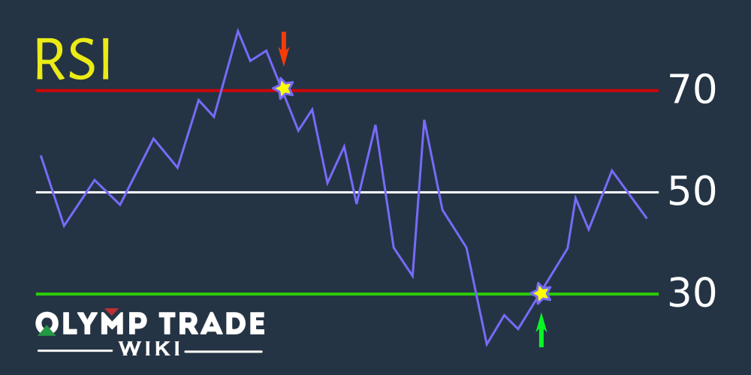
Sell
Buy

Slide 34
RSI
The RSI ranges from 0 to 100.
Traditionally, an RSI value above 70 is considered overbought, suggesting that the asset may be due for a price correction or a potential reversal to the downside.
Conversely, an RSI value below 30 is considered oversold, indicating that the asset may be undervalued and could potentially see a price rebound or a reversal to the upside.

Slide 35
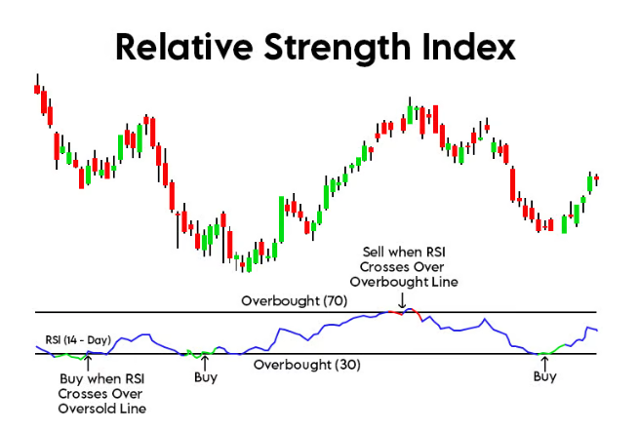
Oversold (30)

Slide 36
RSI – Live Chart

Slide 37
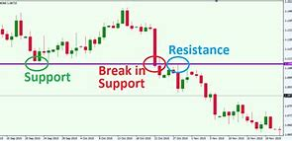

Slide 38
Dow Theory
The Dow Theory has always been a very integral part of technical analysis. The Dow Theory was used extensively even before the western world discovered candlesticks. In fact, even today, Dow Theory concepts are being used. In fact, traders blend the best practices from Candlesticks and Dow Theory.
The Dow Theory was introduced to the world by Charles H. Dow, who also founded the Dow-Jones financial news service (Wall Street Journal). During his time, he wrote a series of articles starting from the 1900s which in the later years was referred to as ‘The Dow Theory’. Much credit goes to William P Hamilton, who compiled these articles with relevant examples over a period of 27 years. Much has changed since the time of Charles Dow, and hence there are supporters and critics of the Dow Theory.

Slide 39
Behavioural Finance
Behavioural finance is a field of study that combines psychology and finance to understand and explain how human behavior influences financial decision-making.
Traditional finance theory assumes that individuals are rational and always make decisions that maximize their economic utility.
However, behavioural finance recognizes that humans are not always perfectly rational and that emotions, biases, and cognitive errors can significantly impact their financial choices.

Slide 40
Cognitive Biases
One of the key concepts in behavioural finance is that of cognitive biases.
Cognitive biases are systematic errors in thinking that can lead to irrational decision-making.
These biases can manifest in various ways, such as overconfidence, anchoring (relying too heavily on initial information), confirmation bias (favoring information that confirms existing beliefs), and loss aversion (the tendency to strongly prefer avoiding losses over acquiring gains).

Slide 41
Emotions
Behavioural finance also examines the impact of emotions on financial decision-making.
Emotions such as fear, greed, and excitement can influence investment choices and lead to suboptimal outcomes.
For example, fear may cause investors to sell their investments during market downturns, while greed may drive them to take excessive risks in pursuit of high returns.

Slide 42
Traditional vs. Behavioural Finance
Traditional finance and behavioural finance differ in their assumptions about human behavior and decision-making processes. Here are some key differences between the two:
Rationality vs. Irrationality
Efficient Markets vs. Market Inefficiencies
Efficient Markets vs. Market Inefficiencies
Risk-Neutral vs. Risk-Averse
Singular Objective vs. Multiple Objectives

Slide 43
Traditional vs. Behavioural Finance
Traditional finance and behavioural finance differ in their assumptions about human behavior and decision-making processes. Here are some key differences between the two:
1. Rationality vs. Irrationality: Traditional finance assumes that individuals are rational and always make decisions that maximize their economic utility. It assumes that investors have access to all relevant information, process it accurately, and make objective judgments. In contrast, behavioural finance recognizes that humans are not always perfectly rational and that emotions, biases, and cognitive errors can significantly impact their financial choices.
2. Efficient Markets vs. Market Inefficiencies: Traditional finance is based on the efficient market hypothesis, which suggests that financial markets incorporate all available information, and prices reflect their fundamental value. It assumes that investors act in a rational manner and that any deviations from fundamental value are quickly corrected. In contrast, behavioural finance suggests that markets are not always efficient and that investor behavior can lead to market inefficiencies, resulting in mispriced assets and opportunities for profit.
3. Predictable vs. Irrational Investor Behavior: Traditional finance assumes that investors behave in a predictable manner, based on their risk preferences and the expected return of assets. It assumes that investors are consistent and make decisions solely based on rational calculations. On the other hand, behavioural finance recognizes that investors are influenced by cognitive biases, emotions, and social factors, leading to irrational and inconsistent behavior. Behavioural finance seeks to understand and explain these deviations from rationality.
4. Risk-Neutral vs. Risk-Averse: Traditional finance assumes that investors are risk-neutral or make decisions solely based on the expected returns and risks associated with different investments. It assumes that investors make decisions to maximize their expected utility, which is solely driven by risk and return. Behavioural finance acknowledges that individuals are generally risk-averse but also recognizes that emotions, biases, and heuristics can influence risk perceptions and decision-making.
5. Singular Objective vs. Multiple Objectives: Traditional finance assumes that investors have a singular objective of maximizing their wealth or financial returns. It focuses primarily on monetary considerations and does not explicitly incorporate non-financial factors. In contrast, behavioural finance recognizes that investors may have multiple objectives, including psychological satisfaction, social influences, and personal values. It acknowledges that investors' decisions are not solely driven by financial considerations.
Overall, behavioural finance challenges the assumptions of traditional finance by incorporating human psychology, cognitive biases, and emotions into the study of financial decision-making. It recognizes that individuals do not always behave rationally and that their behavior can deviate from the predictions of traditional finance models. By understanding these differences, one can gain deeper insights into the complexities of real-world financial decisions.

Slide 44
Traditional vs. Behavioural Finance
Traditional finance and behavioural finance differ in their assumptions about human behavior and decision-making processes. Here are some key differences between the two:
1. Rationality vs. Irrationality: Traditional finance assumes that individuals are rational and always make decisions that maximize their economic utility. It assumes that investors have access to all relevant information, process it accurately, and make objective judgments. In contrast, behavioural finance recognizes that humans are not always perfectly rational and that emotions, biases, and cognitive errors can significantly impact their financial choices.
2. Efficient Markets vs. Market Inefficiencies: Traditional finance is based on the efficient market hypothesis, which suggests that financial markets incorporate all available information, and prices reflect their fundamental value. It assumes that investors act in a rational manner and that any deviations from fundamental value are quickly corrected. In contrast, behavioural finance suggests that markets are not always efficient and that investor behavior can lead to market inefficiencies, resulting in mispriced assets and opportunities for profit.
3. Predictable vs. Irrational Investor Behavior: Traditional finance assumes that investors behave in a predictable manner, based on their risk preferences and the expected return of assets. It assumes that investors are consistent and make decisions solely based on rational calculations. On the other hand, behavioural finance recognizes that investors are influenced by cognitive biases, emotions, and social factors, leading to irrational and inconsistent behavior. Behavioural finance seeks to understand and explain these deviations from rationality.
4. Risk-Neutral vs. Risk-Averse: Traditional finance assumes that investors are risk-neutral or make decisions solely based on the expected returns and risks associated with different investments. It assumes that investors make decisions to maximize their expected utility, which is solely driven by risk and return. Behavioural finance acknowledges that individuals are generally risk-averse but also recognizes that emotions, biases, and heuristics can influence risk perceptions and decision-making.
5. Singular Objective vs. Multiple Objectives: Traditional finance assumes that investors have a singular objective of maximizing their wealth or financial returns. It focuses primarily on monetary considerations and does not explicitly incorporate non-financial factors. In contrast, behavioural finance recognizes that investors may have multiple objectives, including psychological satisfaction, social influences, and personal values. It acknowledges that investors' decisions are not solely driven by financial considerations.
Overall, behavioural finance challenges the assumptions of traditional finance by incorporating human psychology, cognitive biases, and emotions into the study of financial decision-making. It recognizes that individuals do not always behave rationally and that their behavior can deviate from the predictions of traditional finance models. By understanding these differences, one can gain deeper insights into the complexities of real-world financial decisions.

Slide 45


Slide 46


